Slide 1
Business Process Modelling and Enterprise Architecture
&
Advanced Information Systems Development
Dilshan Jayatilake
&
Rumali Sirimanne

Slide 2
Session Plan
Group Formation
Setting Up Camunda Environment
  Install Camunda
  Running the Camunda 7 cluster locally
  Explore Camunda
  Camunda Running!!!
Group Task: Case Study Analysis
Group Activities Checklist

Slide 3
Group Formation
Groups must consist of 4 – 5 students
Once groups are set, no changes will be allowed
Every group member must contribute to ALL tasks
Collaboration and equal participation are mandatory

Slide 4
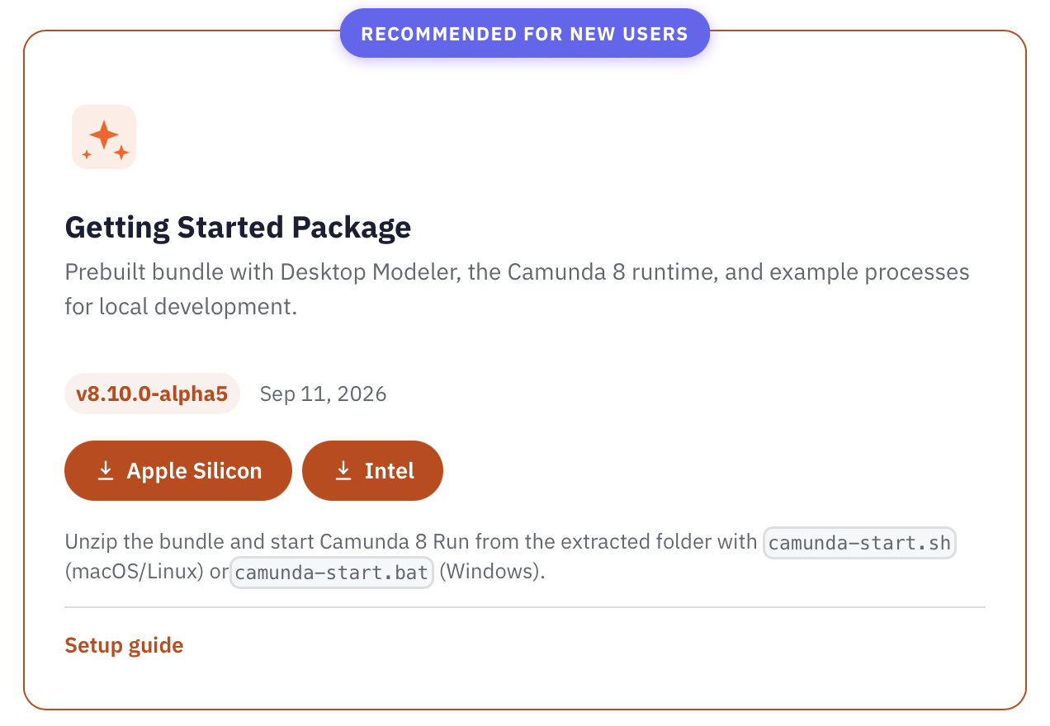
Setting Up Camunda Environment
Install Environment
Install Java Runtime Environment (Java 21–23 (LTS versions))
Download and install
Download and install Camunda 8 Platform
Install
Install Camunda Modeler for BPMN diagrams
JDK 24+ isn’t supported yet
Goto https://docs.camunda.io/downloads/

Slide 5
Setting Up Camunda Environment
Explore
camunda-starter – this is your one-click (or one-command) start script for the whole Camunda 8 stack.
Explore Camunda Webapps:
Cockpit (monitoring)
Tasklist (user tasks)
Admin (user management)
Verify installation by deploying a sample process
Camunda Modeler – the Camunda Modeler application for designing processes.
ai-agent-example – a pre-designed AI agent example built with Camunda
c8run – the directory containing the C8 Run engine and its configs.
camunda-8-get-started – an example project with a ready-made BPMN process and code (in Java and NodeJS) for service tasks.

Slide 6
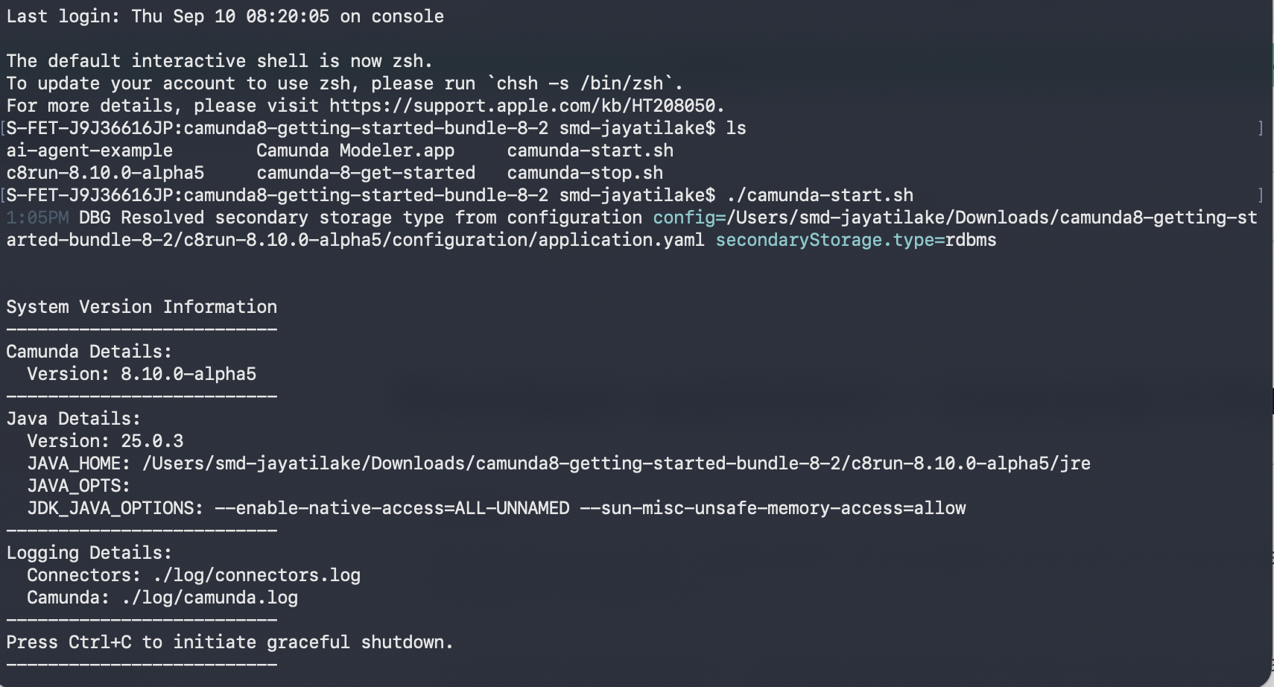
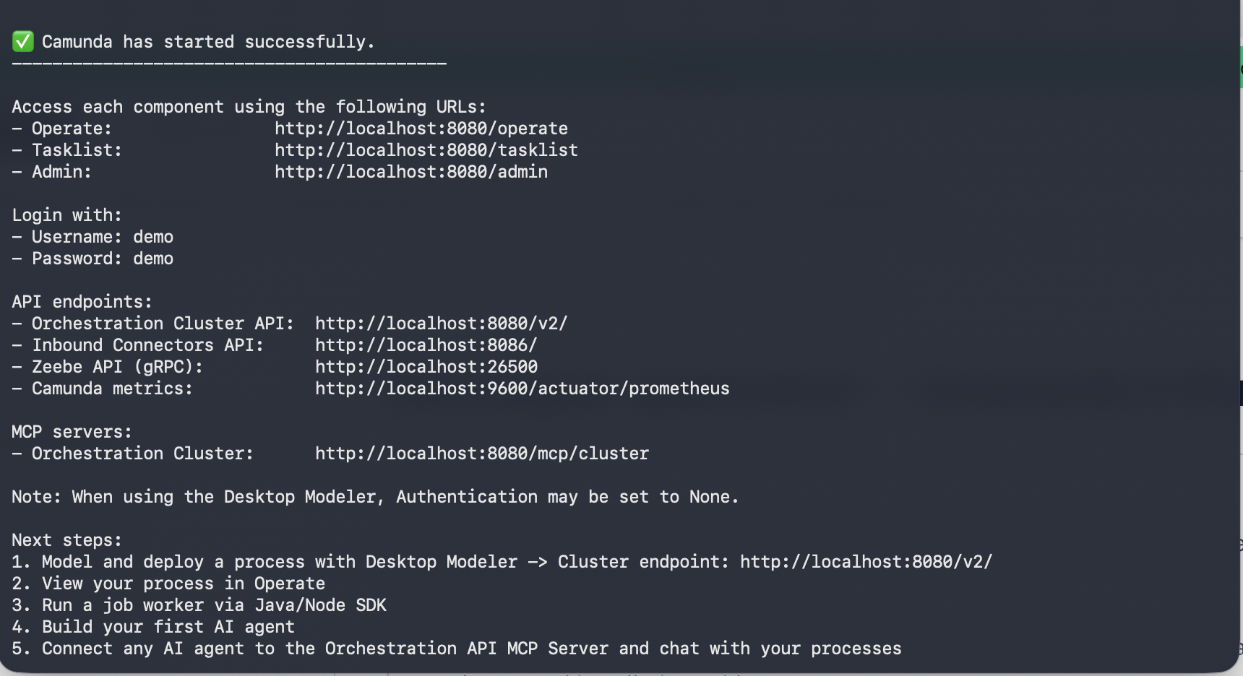
Launch Camunda 8 Run
To start Camunda 8 Run, follow these simple steps:
  Open a terminal (or command prompt) and navigate to the unzipped starter folder.
  Run the start script. If you’re on
    Windows: camunda-starter.bat
    Mac/Linux: run ./camunda-starter.sh
  Watch the logs in the terminal.
  You should see messages indicating that web interfaces are available at http://localhost:8080 for various tools (Operate, Tasklist, etc.)

Slide 7
Running the Camunda 8 cluster locally
Access each component using the following URLs:
  Operate: http://localhost:8080/operate
  Tasklist: http://localhost:8080/tasklist
  Admin: http://localhost:8080/admin
Login with:
  Username: demo
  Password: demo

Slide 8
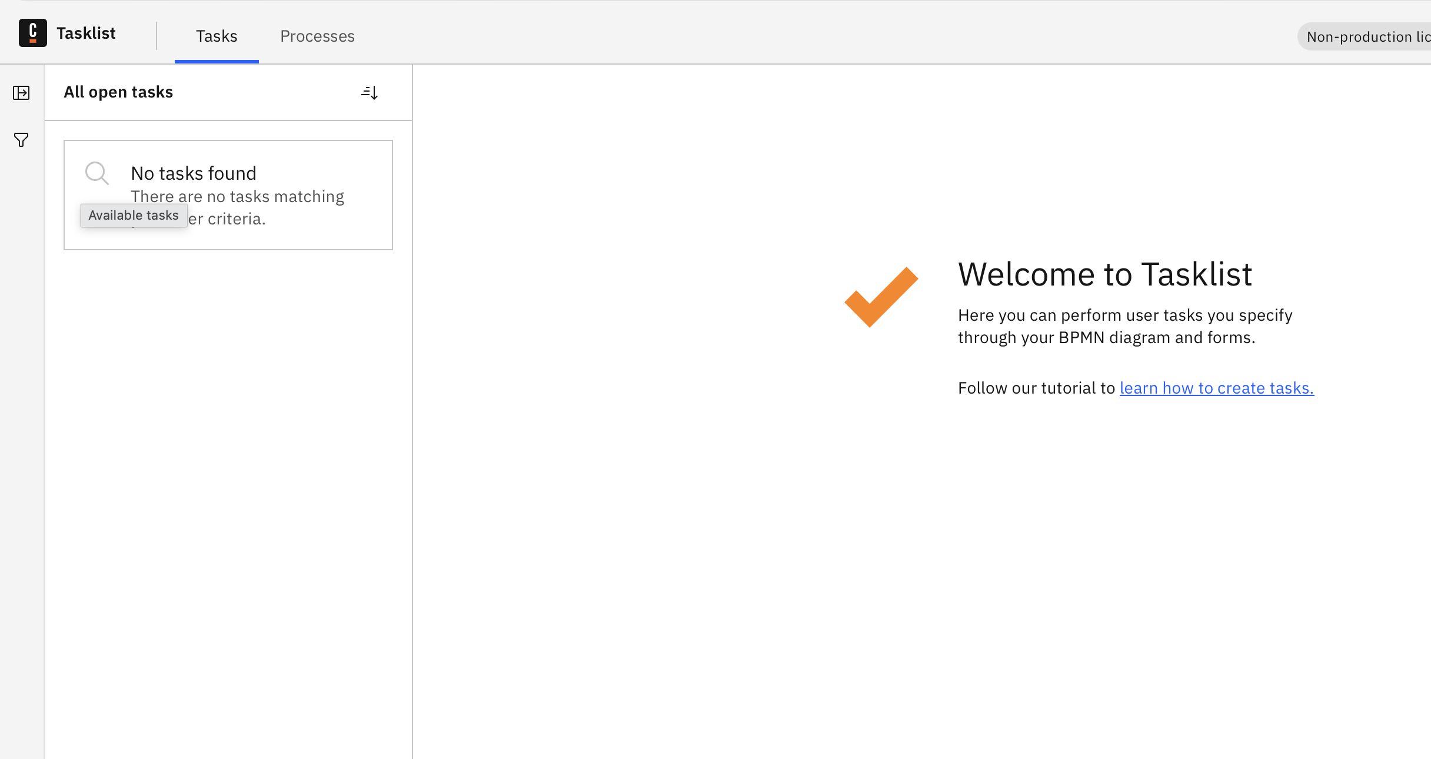
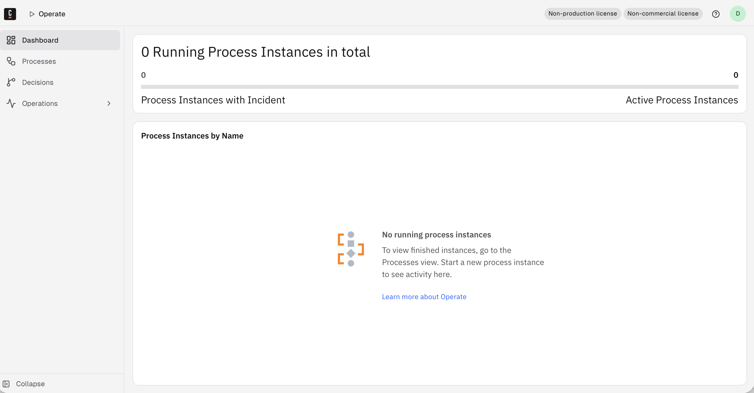
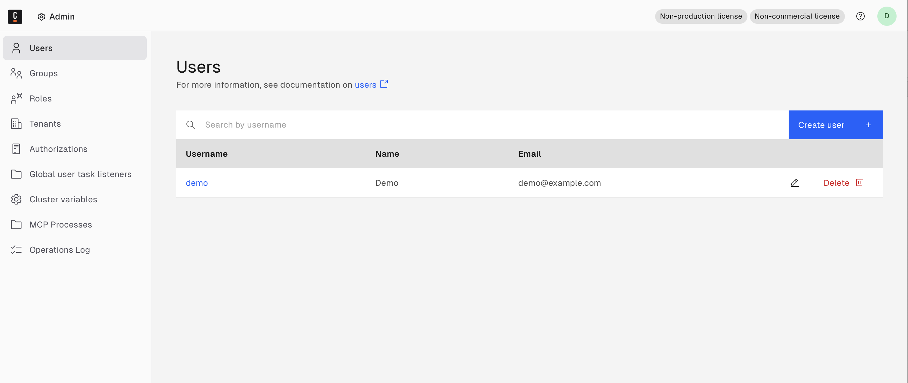
You should see…
Operate
Task List
Admin

Slide 9
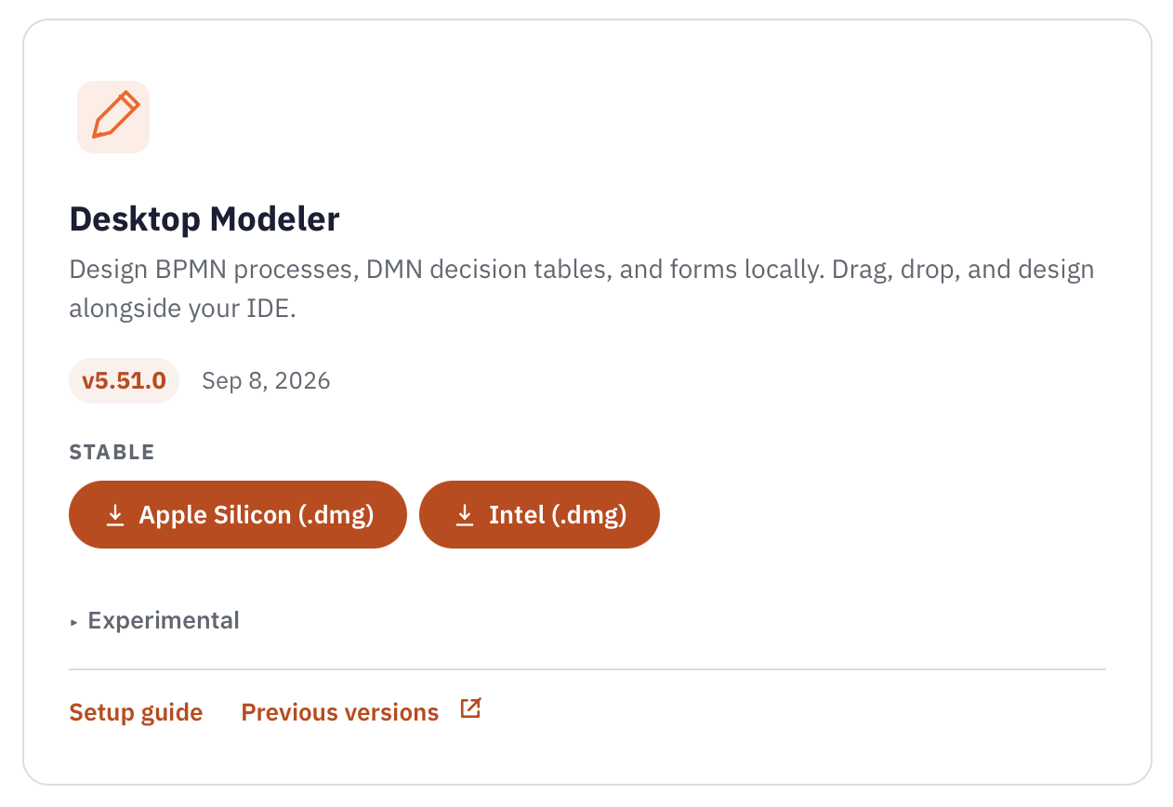
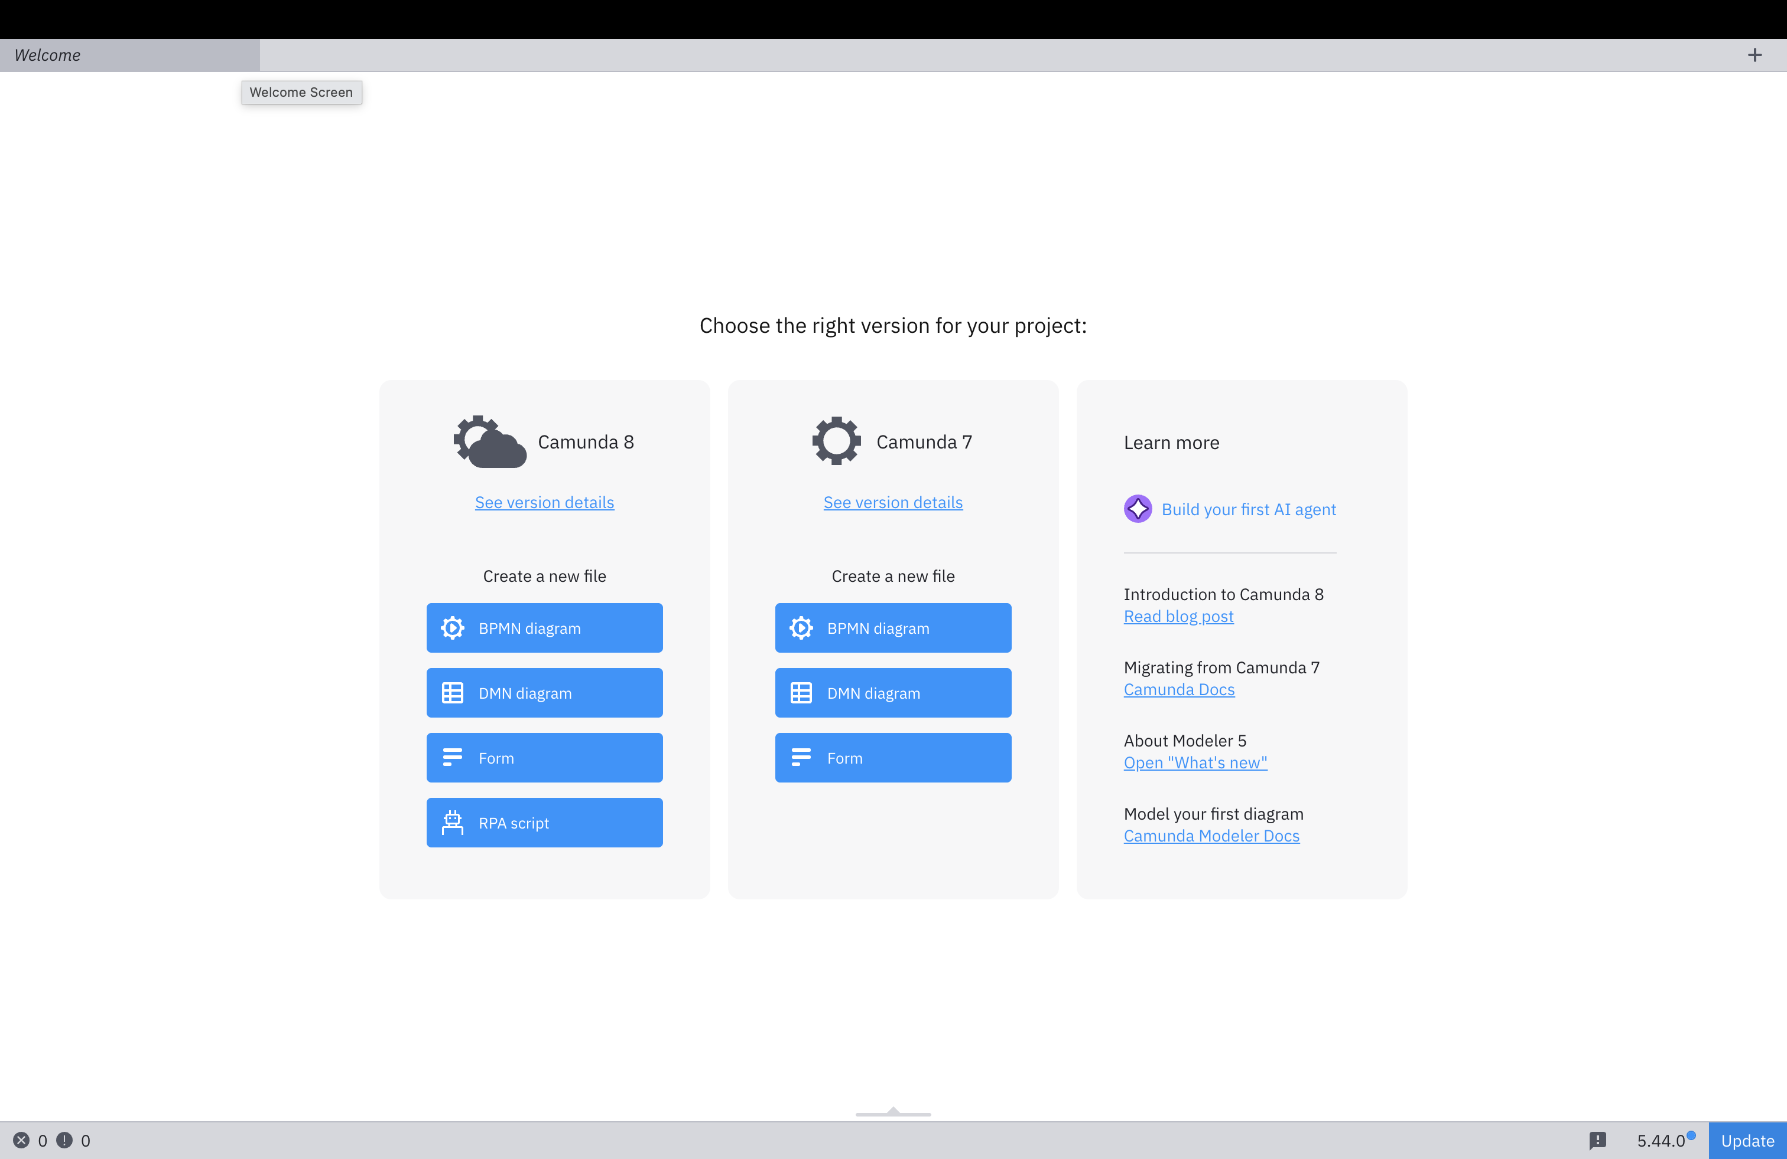
Camunda Modeler
Go to: https://camunda.com/download/modeler/
Select the download the correct variant based on your operating system
Download and Install
Run

Slide 10
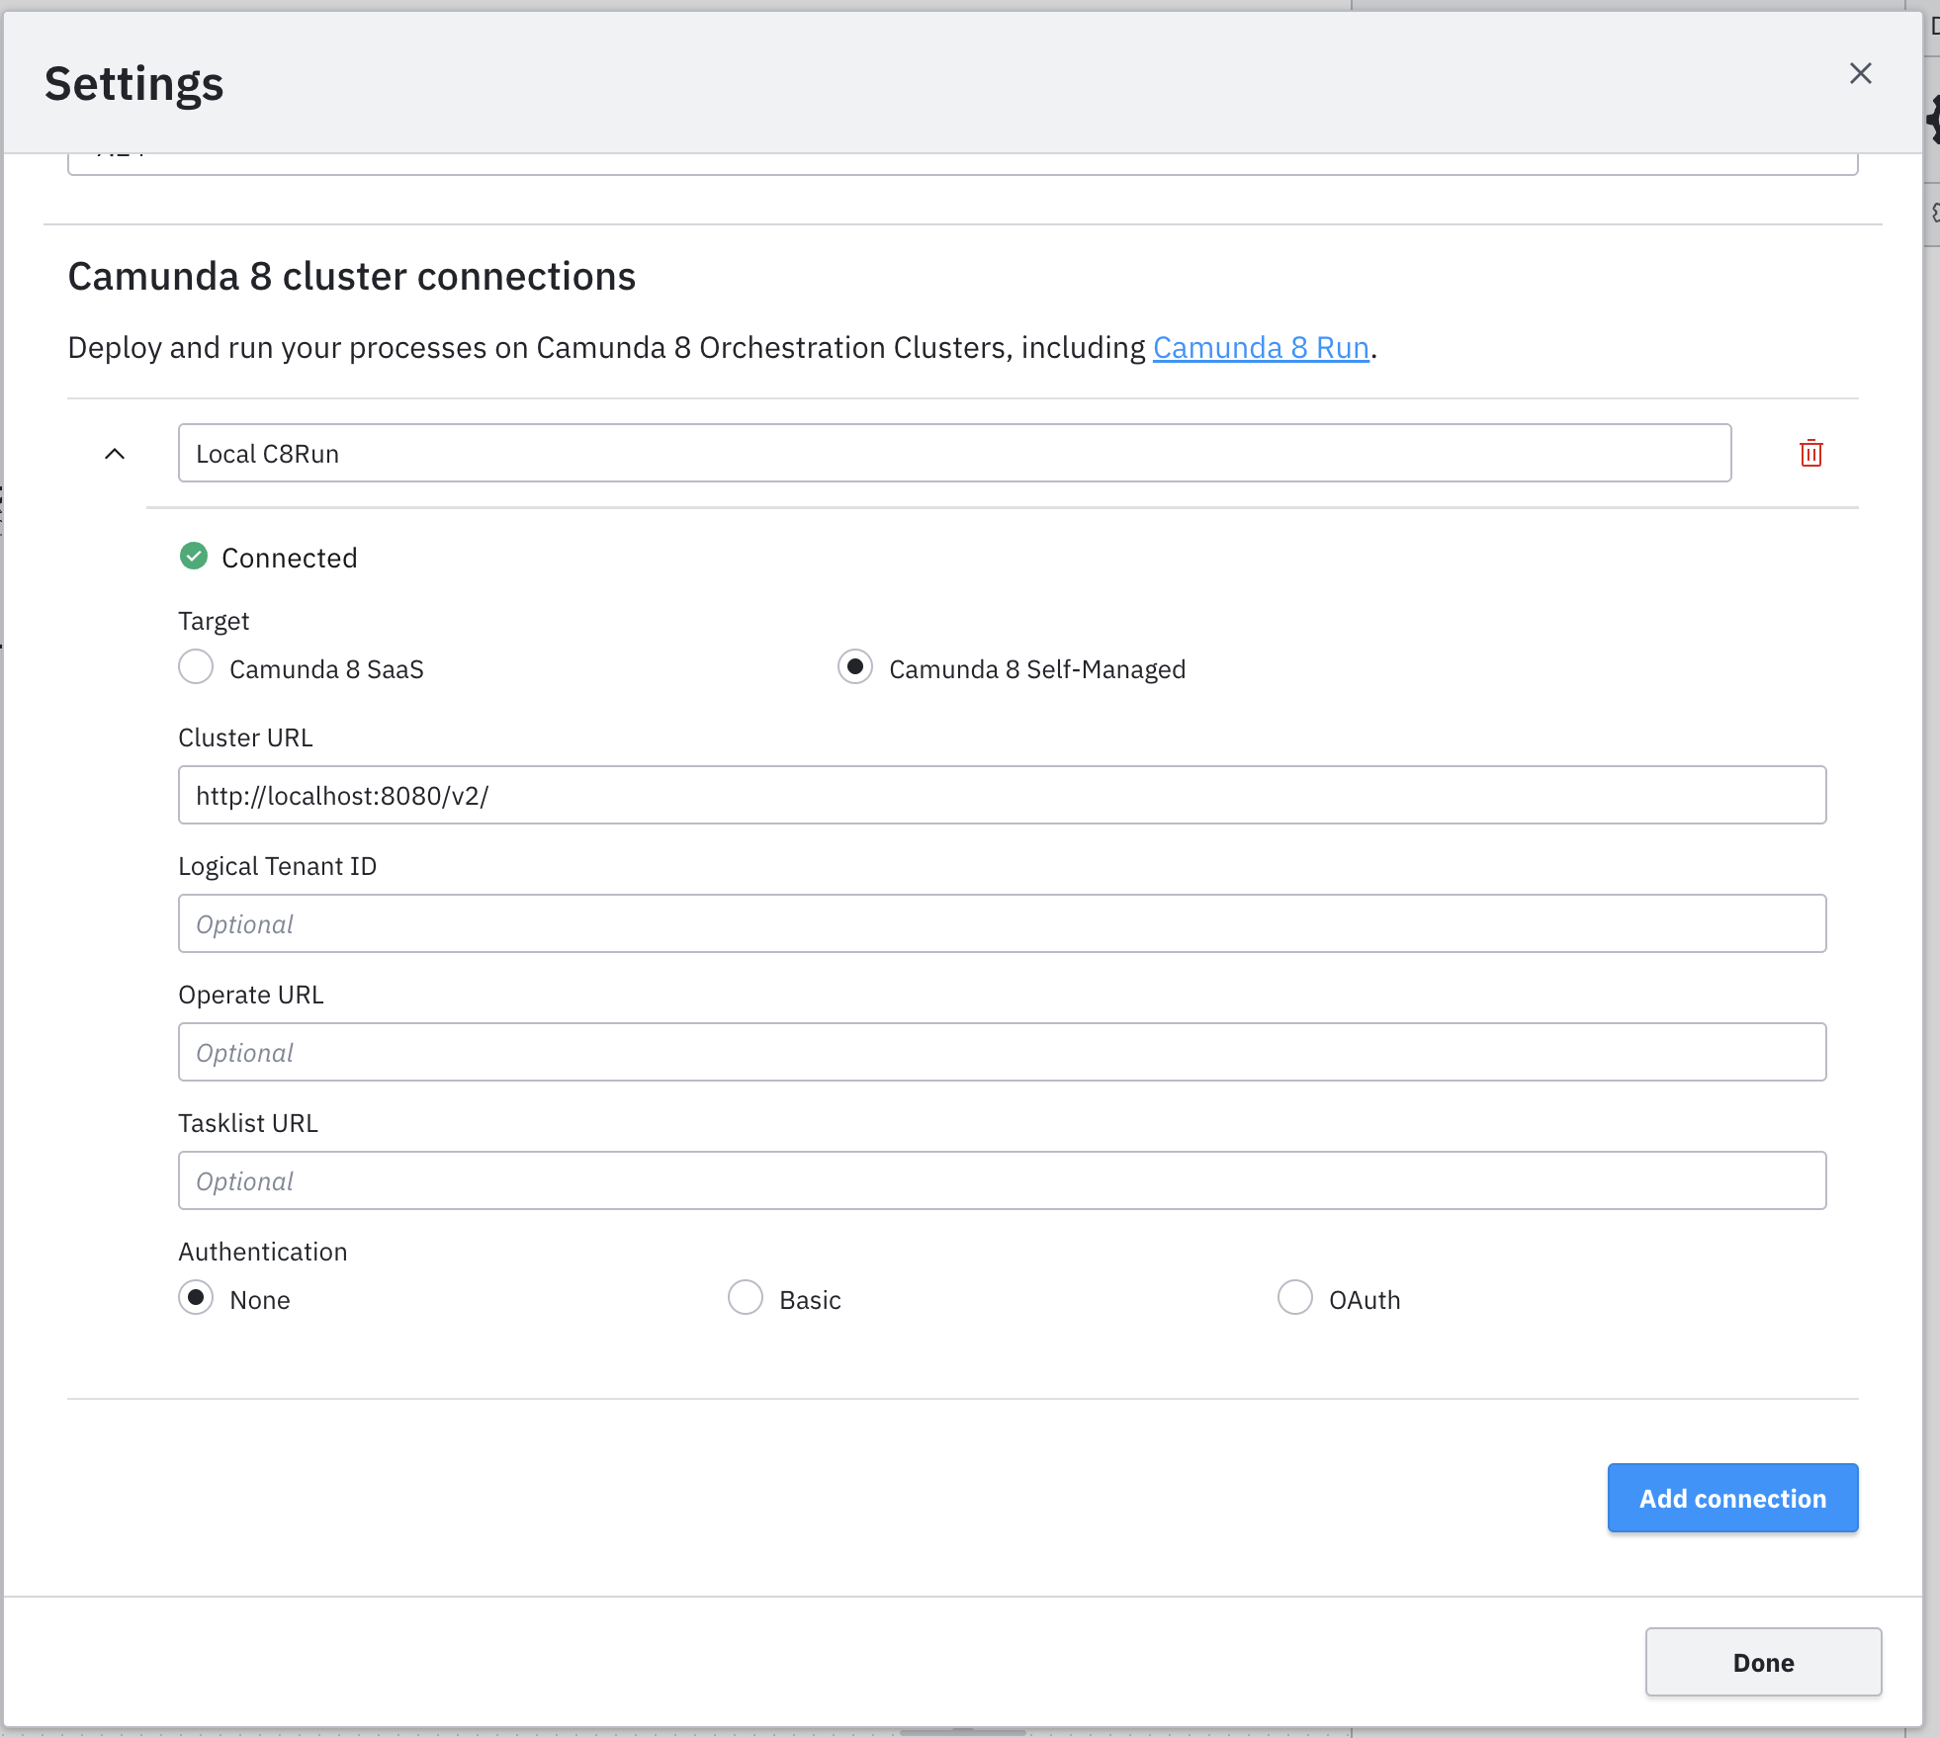
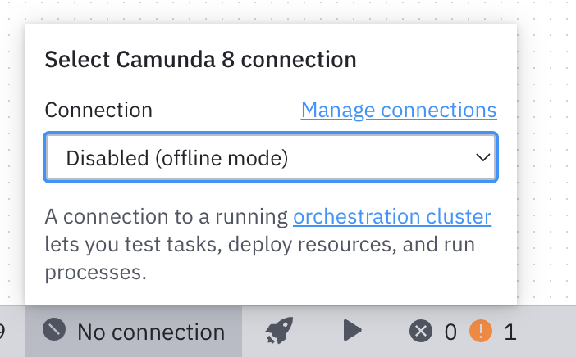
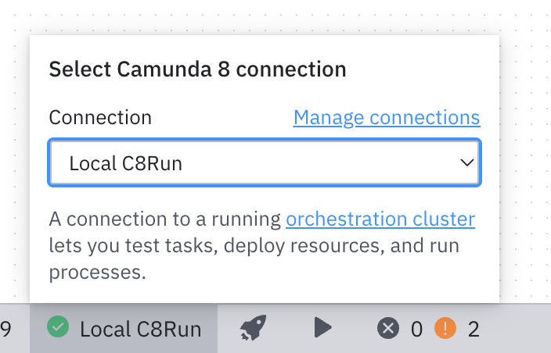
Running Camunda
First, launch the Camunda Modeler application.
Configure the connection
  Cluster endpoint: http://localhost:8080/v2/
  or
  Zeebe API (gRPC): http://localhost:26500
  You can find this on the console.
Select Camunda connection as the connection you just created.

Slide 11
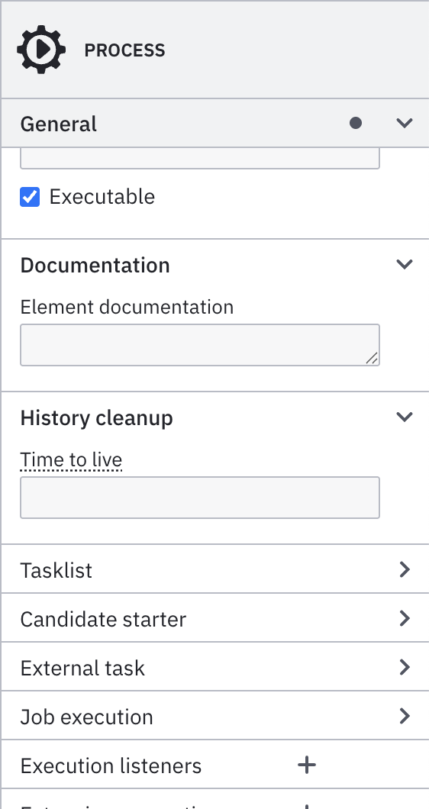
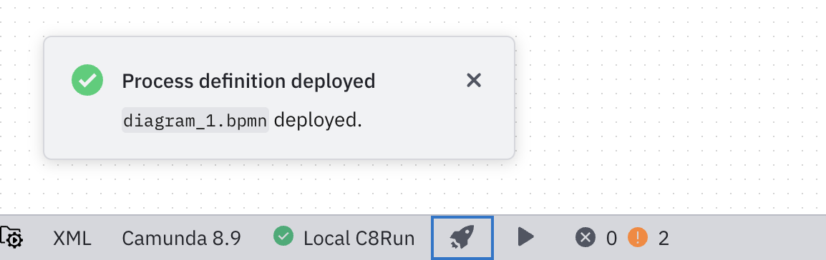
Running Camunda
First, launch the Camunda Modeler application.
  Make sure your model is executable
Deploying the process to the engine.
Click Rocket icon on the bottom ribbon
  Go to: http://localhost:8080/tasklist/processes
You should see your process ready to start.
  Go to: http://localhost:8080/operate/
  Observe the process that you just started.

Slide 12

Find your group
Group Size : 5
Group stays throughout the both units AISD & BPM&EA
Once you set the groups you cannot change groups
Individual contributions will be accounted for individual marks

Slide 13
Group Task: Case Study Analysis
Read and discuss the provided case study
Identify key business processes
Model the AS-IS and TO-BE processes using BPMN
Document your findings for discussion in class

Slide 14
Group Activities Checklist
Form your group (4–5 members)
Register your group
Analyse the case study collaboratively
Set up Camunda 8 on all members’ laptops
Confirm successful deployment of a test process

Slide 15
Business Process Modelling and Enterprise Architecture
&
Advanced Information Systems Development
Group Allocation and Environment Setup
Dilshan Jayatilake
&
Rumali Sirimanne

